Slide 1
Web Storage API
Mr. Anbuselvan Annamalai
www.anbuselvan-annamalai.com
Browser Storage in JavaScript
- தமிழில்
Mastering Local Storage, Session Storage, Cookies & IndexedDB

Slide 2

🕰️ How web works?

Slide 3

What is Browser Storage?
Mechanism to store data on the client-side.
Three Main Types:
localStorage
sessionStorage
Cookies

Slide 4
Local Storage
Key-value storage that stores values as strings
Does not have expiration date (persistent storage) unless explicitly clear the browser using settings or JavaScript
Up to 10MB data can be stored
Follow the same-origin policy, which means the Protocol(Http/Https), port and the host are the same. Only scripts of the same origin can access localStorage data
Do not send to server, for client-side usage only
Use case: Store user-related data like theme, language, etc.

Slide 5

Session Storage
Key-value storage that stores values as strings
Data stored does not survive after the table/window is closed
Up to 10MB data can be stored
Follow the same-origin policy and is bound to a tab
Do not send to server, for client-side usage only
Use case:
Store user-related data for one session only like language selection

Slide 6
What is a cookie
An HTTP cookie is a piece of data that a server sends to a web browser.
Then, the web browser stores the HTTP cookie on the user’s computer and sends it back to the same server in the later requests.
An HTTP cookie is also known as a web cookie or browser cookie. And it is commonly called a cookie.

Slide 7
Why cookies?
HTTP is Stateless!
Session management – cookies allow you to manage any information that the server should remember. For example, logins, shopping carts, etc.
Personalization – cookies allow you to store user preferences, themes, and setting specific to a user.
Tracking – cookies help record and analyze user behaviors in advertising.

Slide 8
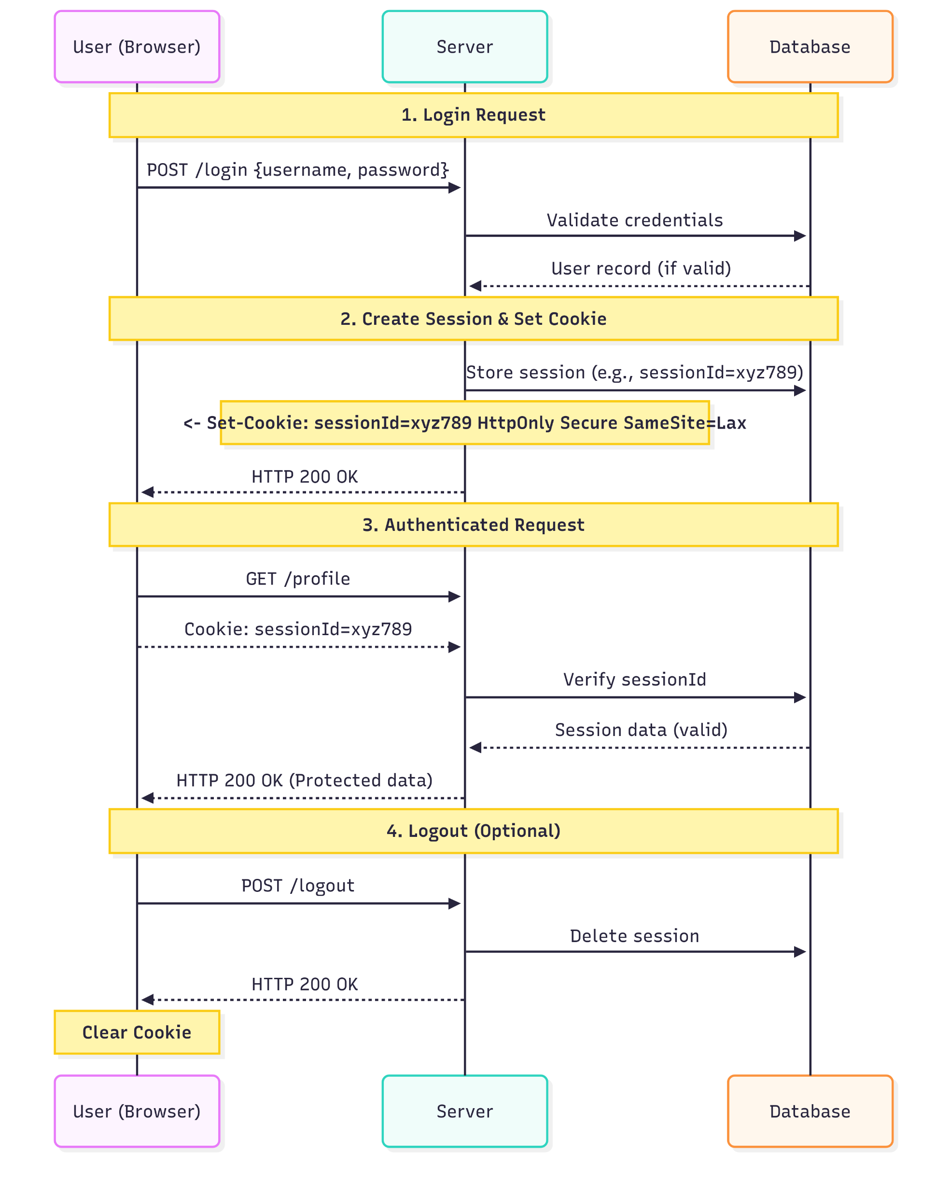

Slide 9
Cookie details
Name – a unique name that identifies the cookie. The cookie names are case-insensitive. It means that Username and username are the same cookies.
Value – string value of the cookie. It must be URL-encoded.
Domain – a domain for which the cookie is valid.
Path – path without the domain for which the cookie should be sent to the server.
(For example, you can specify that the cookie is accessible only from the https://cyberdudenetworks.com/app/ so pages at https://cyberdudenetworks.com/ won’t send the cookie information.)

Slide 10
Cookie details
Expiration – timestamp that indicates when the web browser should delete the cookie (or when the browser should stop sending the cookie to the server). The expiration date is set as a date in GMT format: Wdy, DD-Mon-YYYY HH:MM:SS GMT. The expiration date allows the cookies to be stored in the user’s web browsers even after users close the web browsers.
Secure flag – if specified, the web browser only sends the cookie to the server only via an SSL connection (https, not http)

Slide 11
Cookie
Key-value storage that stores values as string
Have expiration time, if no expiration time is given then the cookie will get expired at the end of the browser session.
Up to 4KB data can be stored
Send to server for every request and follow same-origin policy
Use case: Server can get data from cookie to track session status.

Slide 12


Creating cookie
JavaScript
Web Server
document.cookie
Set-cookie header

Slide 13
Cookies Properties
Sent with every request
Cookie Scope
Domain
Path
Expires, max-age
Same site
Secure
httpOnly

Slide 14

Cookie types
Session cookies
Permanent cookies
httpOnly cookies
Secure cookies
Thirty-party cookies
Zombie cookies

Slide 15
Cookie security
Stealing cookies
Cross Site Request Forgery (CSRF attack)

Slide 16
IndexedDB
Can store both objects and key-value pairs
Up to 250MB for IE
IndexedDB API is asynchronous, unlike local storage and session storage. IndexedDB operations are event-driven by various events like onSuccess, onError, onComplete etc.
Follow the same-origin policy
Do not have expiration time (persistent storage) unless explicit deletion
Use case: When need to store a large number of objects which is time-consuming and a lag on performance to convert to string for Local Storage every time.

Slide 17
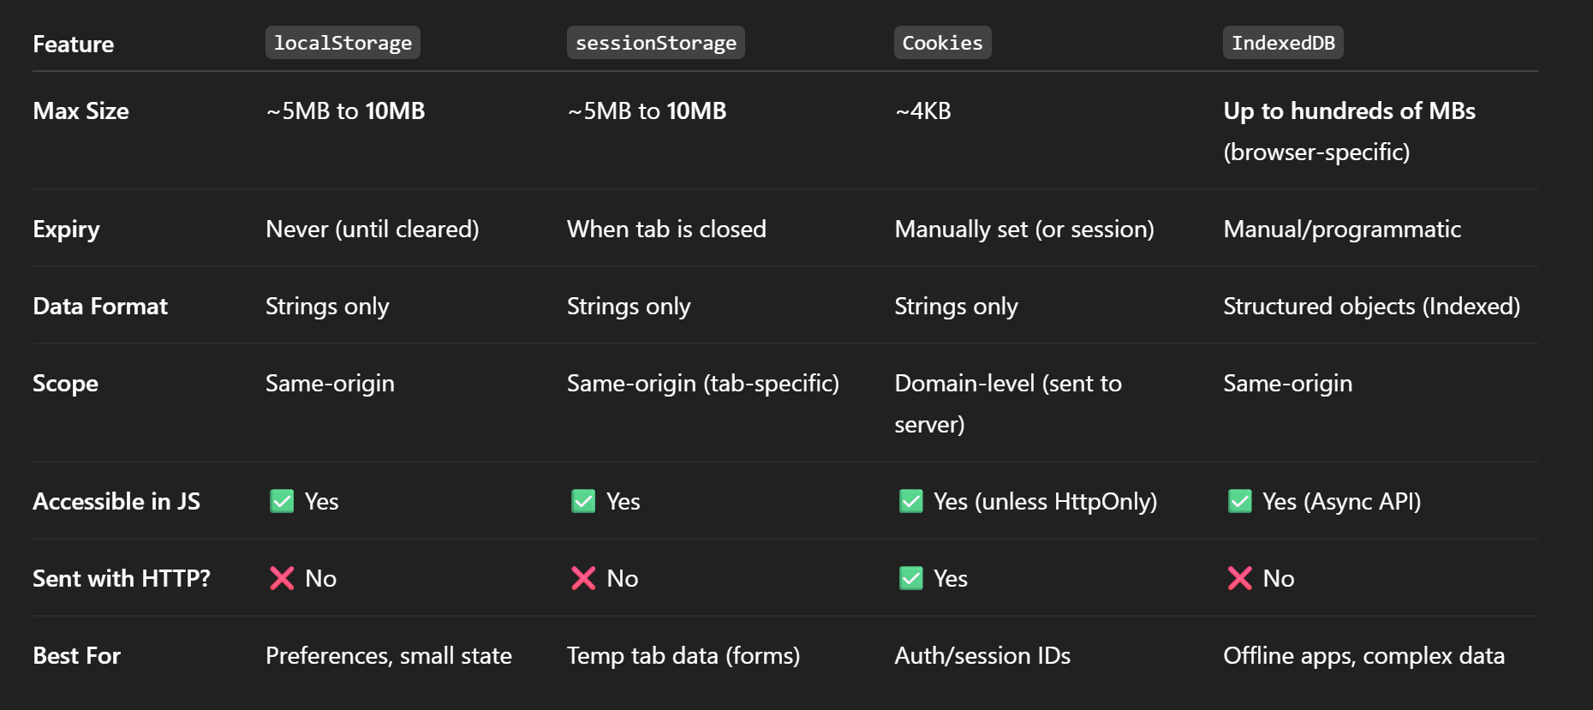
Quick Comparison

